Slide 1

Himanshu Singh WEB-DEVELOPMENT COURSE
J.S.S ACADEMY OF TECHNICAL EDUCATION, NOIDA
Welcome to The
SUBMITTED BY :
KRAPI RASTOGI
2000910130054
B.TECH 2nd YEAR Information Technology

Slide 2

WEB-DEVELOPMENT
COURSE CONTENT
Introduction to Website
HTML(Hyper Text Markup Language)
CSS(Cascading Style Sheets)
JavaScript
Project Overview

Slide 3
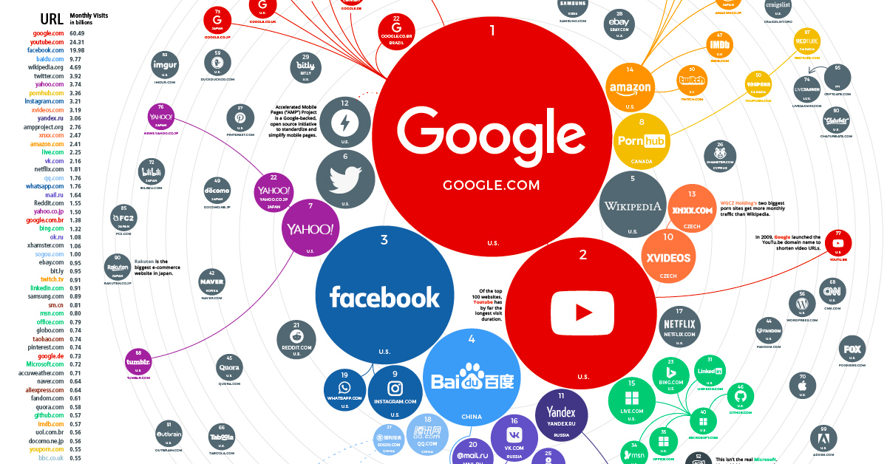

Introduction of web
What is a Website-
Set of related webpages under a single domain name.
Contain Hyperlinks to each other.
Made by an individual , company or government.

Slide 4






Requirements of This Course
Web Browser(Google Chrome , Mozilla Firefox
Mozilla Firefox
Text editor(Notepad++ , Notepad )
Notepad
Google Chrome

Slide 5

HTML
HTML - Hyper Text Markup language.
Building block of any website.
Main language which is used to create web pages on the internet.
Everything that appears on web page is HTML.
We can check the HTML code of any webpage by checking its source page.
Allow users to organise the appearance of webpage.

Slide 6
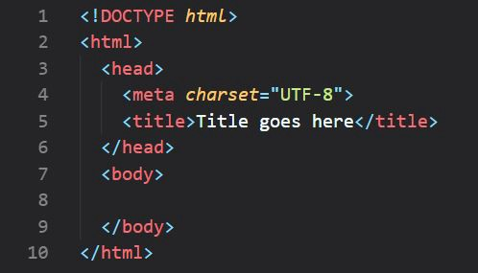
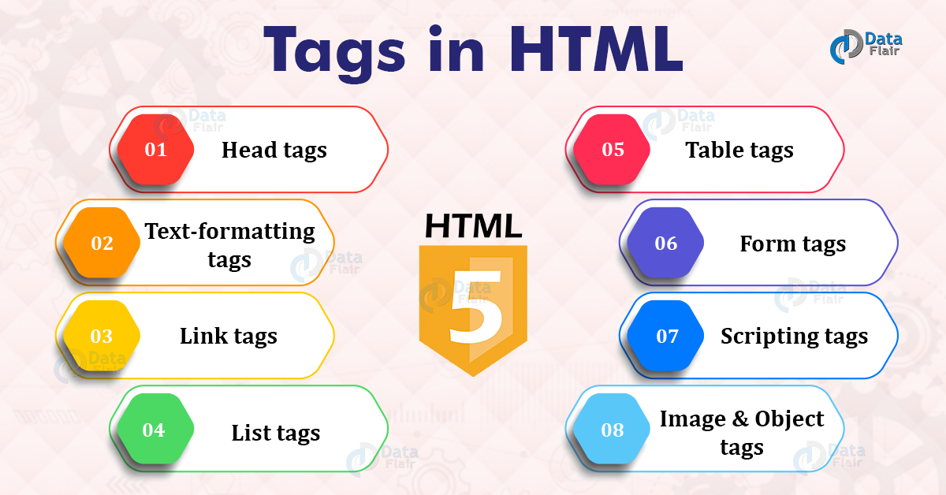
Basic Structure of HTML
Tags in HTML

Slide 7
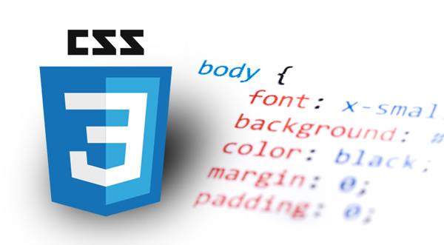
CSS
CSS - Cascading Style Sheet.
Used to format the layout of the web page.
Language used to style an HTML document.
Describes how HTML elements should display.
Allows to add fonts , colours , background , spacing etc.

Slide 8
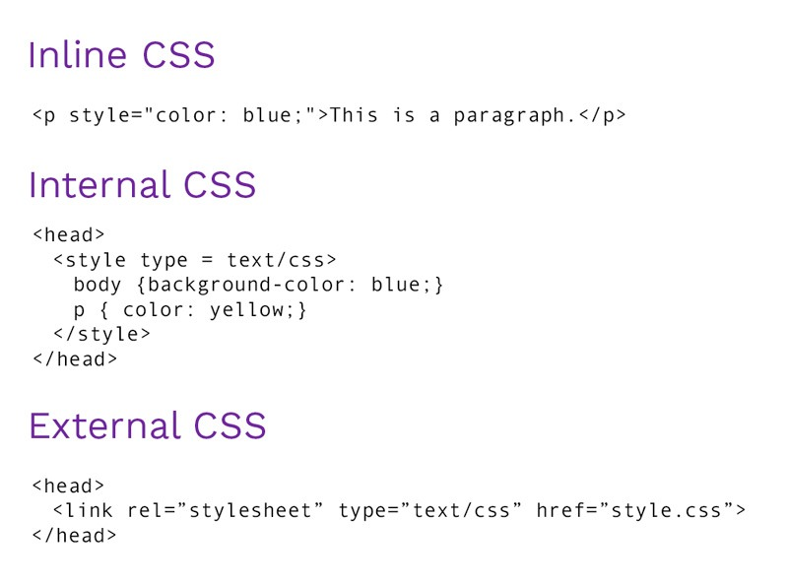
Structure of CSS and Implementation.
CSS can be added to HTML document in 3 ways:-
Inline
Internal
External

Slide 9


JavaScript
Introduced in year 1995.
Structured , Lightweight and Interpreted language.
Makes Website Alive.
Add direct interactivity with the websites.
Provides good control to the user.
Applications:-
Displaying dates and times.
Displaying pop up windows and dialog boxes.
Displaying clocks.

Slide 10

Project overview

Slide 11
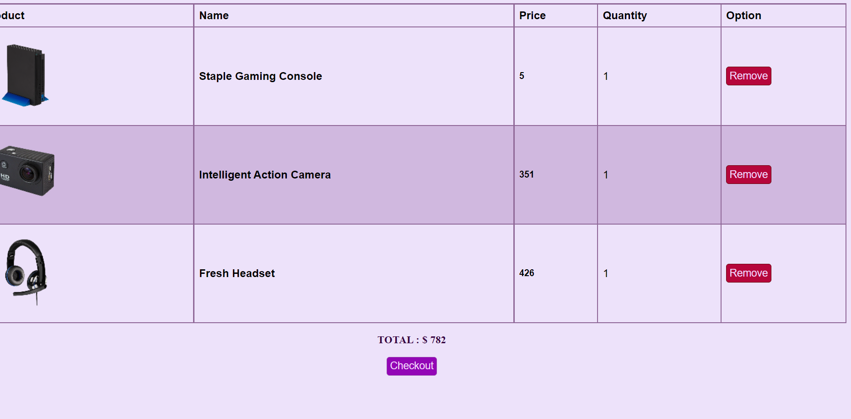
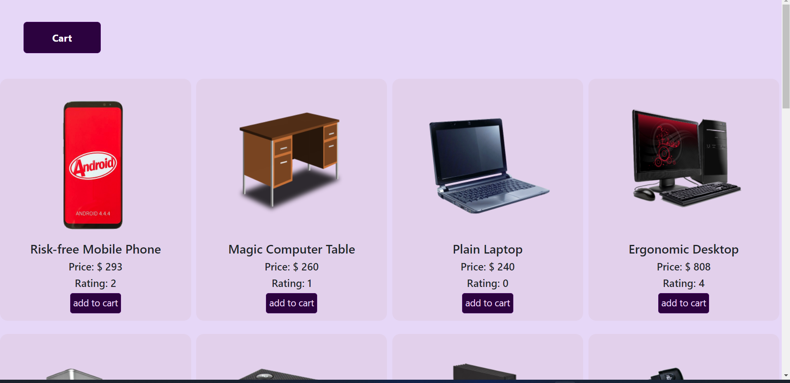
Cart Section
It is a shopping websites in which we can choose the products as our requirement and add to the cart section.
Later we can see the chosen products with total price.

Slide 12
Thank - you

